Slide 1

Introduction to Angular

Slide 2
What is Angular ?
Angular is an,JavaScript framework written in TypeScript. and its primary purpose is to develop single-page applications. As a framework, Angular has clear advantages while also providing a standard structure for developers to work with. It enables users to create large applications in a maintainable manner

Slide 3
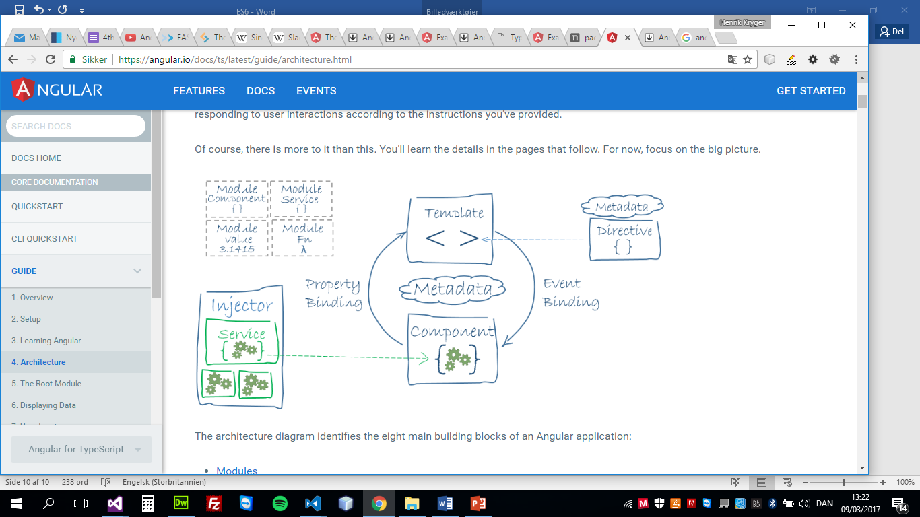
Angular Architecture
The architecture diagram identifies the eight main building blocks of an Angular application
Modules
Components
Templates
Metadata
Data binding
Directives
Services
Dependency injection

Slide 4
Modules
Every Angular applications have at least one module - the RootModule by convention named AppModule.
Larger Angular applications will have feature and route modules as well
Angular Modules helps organizing the application into cohesive blocks of functionality.
A module is implemented as a class.

Slide 5
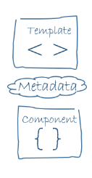
Components
A component consists of tree parts
A Template
A Decorator
A TypeScript class

Slide 6
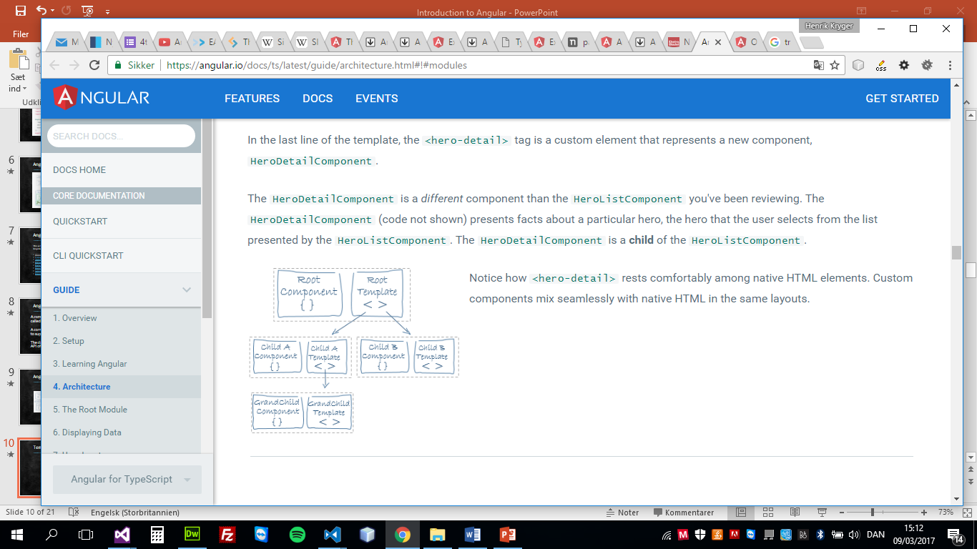
Template
A template is a form of HTML that tells Angular how to render the component.

Slide 7
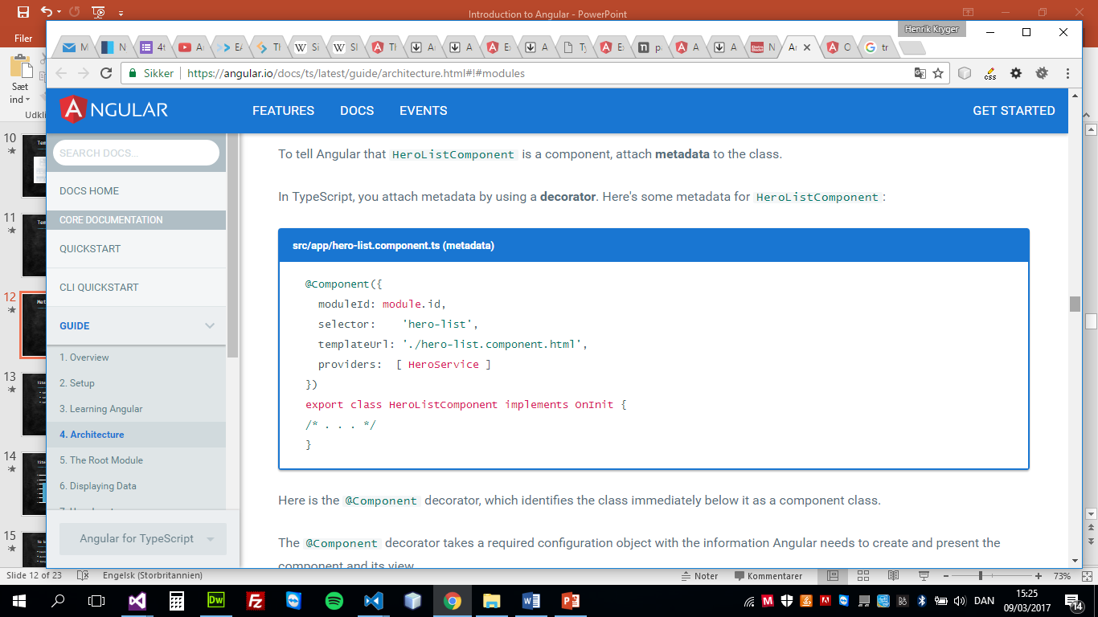
Metadata
Metadata tells Angular how to process a class.
To tell Angular that it’s a component, attach metadata to the class. In TypeScript, you attach metadata by using a decorator

Slide 8
Data binding
Data Binding is the mechanism that binds the applications UI or User Interface to the models. Using Data Binding, the user will be able to manipulate the elements present on the website using the browser. Therefore, whenever some variable has been changed, that particular change must be reflected in the Document Object Model or the DOM.
One-way Data Binding
Interpolation
Property Binding
Event Binding
Two-way Data Binding

Slide 9
Directives
Directives are classes that add new behavior or modify the existing behavior to the elements in the template.
Basically directives are used to manipulate the DOM, for example adding/removing the element from DOM or changing the appearance of the DOM elements.
Component directive
Structural directive
Attribute directive

Slide 10
Directives
1. Component directive
Components are special directives in Angular.
They are the directive with a template
2.Structural directive
Structural directives are used to change the DOM layout by adding and removing DOM elements. It basically changes the structure of the DOM Examples of structural directives are ngIf, ngFor, ngSwitch
3.Attribute directive
Attribute directives are used to change the appearance or behavior of an element.

Slide 11
Services
Service is a piece of reusable code with a focused purpose. A code that you will use in many components across your application
Share logic or data across components
Encapsulate external interactions like data access

Slide 12
Dependency injection
Dependency injection is a way to supply a new instance of a class with the dependencies it requires. Most dependencies are services.
Angular uses dependency injection to provide new components with the services they need.
Constructor injection: Here, it provides the dependencies through a class constructor.

Slide 13
Input & Output
Component interaction
Passing data from parent to child using: @Input( ) and property-binding Passing data from child to parent using: @Output( ) , EventEmitter and event-binding (The parent listens for child event)

Slide 14
Routing &navigation
Navigation is one of the important aspect in a web application. Even though a single page application (SPA) does not have multiple page concept, it does moves from one view (list of expenses) to another view (expense details). Providing clear and understandable navigation elements decides the success of an application
The router outlet,
Routes and paths,
Navigation.
Navigating
Navigate programmatically (imperatively) by injecting the Router via the constructor:
constructor(private router:Router){}
this.router.navigate(['/movie-list']);

